Slide 1
PHYS 304: Lecture 8 (Intro to) Quantum Mechanics
Sept-Dec 2021 Edition
Jeff Young
brimacombe Rm 278, young@phas.ubc.ca

Slide 2
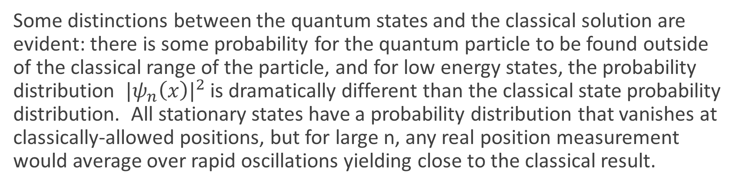
Review of Key points from last day
Solutions for the harmonic oscillator potential are slightly more challenging, mathematically, than the infinite square well, but still fairly straight forward.
The results are qualitatively similar in that there are discrete energies at which stationary state solutions exist, and the corresponding wavefunctions have an increasing number of nodes and anti-nodes to them as their energy increases. The spacing between energy levels is however fixed.
Some distinctions between the quantum states and the classical solution are evident: there is some probability for the quantum particle to be found outside of the classical range of the particle, and for low energy states, the probability distribution ${|ψ_{n}\left(x\right)|}^{2}$ is dramatically different than the classical state probability distribution. All stationary states have a probability distribution that vanishes at classically-allowed positions, but for large n, any real position measurement would average over rapid oscillations yielding close to the classical result.

Slide 3
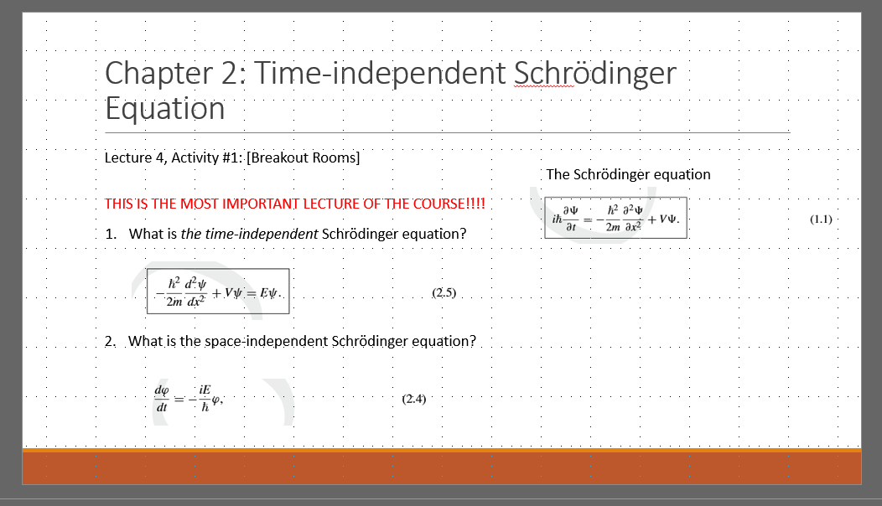
Today: The free particle (V(x)=0)
Follow the “recipe” - that you should now be intimately familiar with – for constructing and analyzing the dynamical properties of non-stationary states of particle.
Note that the basic set of steps we are going to follow is identical to what we did for previous examples. Go back to Lectures 4 and 5 “The most important lectures in the course”.
Recall: why is it that we need to construct and analyze non-stationary states in order to study dynamics?
Notes:
Emphasize that they MUST thoroughly understand everything on this page to master the first half of the course.

Slide 4
The free particle
Lecture 8, Activity 1: (TPS ~ 3 minutes)
What is the general form of an apparent “stationary state” solution of Schrödinger equation for a particle in free space, and why can’t it be normalized?
Why is this distinct from the reason that we “threw out” some of the mathematically-allowed solutions to the time-independent Schrödinger equation when we dealt with the harmonic oscillator problem, or why we don’t consider stationary solutions for this free particle case when E_{k}<0?
Notes:
e^i((+/-)sqrt(2mE/hbar^2-E/hbar*t)
Because the wf itself doesn’t diverge, it is only the fact that it doesn’t go to zero at +/- infinity that is the problem…hence can be “fixed” (see later)

Slide 5
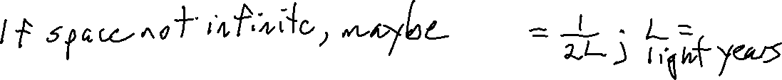




The free particle
Lecture 8, Activity 1:
Notes:
e^i((+/-)sqrt(2mE/hbar^2-E/hbar*t)
The problem: C would have to be zero since the probability density is unity for all x.
It is distinct from the E<0 problem because the functional form of the wf itself doesn’t diverge, it is only the fact that it doesn’t go to zero at +/- infinity that is the problem…hence can be “fixed” (see later). Can sort of guess how it might be fixed by taking some sort of limit, assuming space isn’t actually infinite.

Slide 6
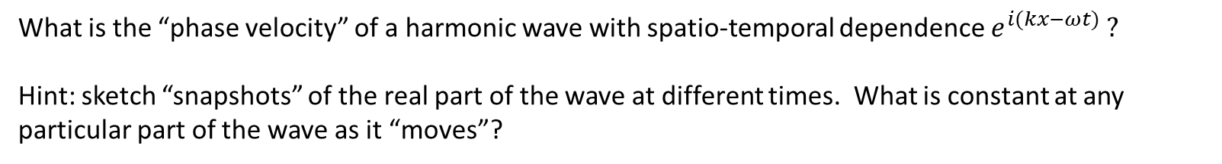
Lecture 8, Activity 2: (TPS ~ 3 minutes)
What is the “phase velocity” of a harmonic wave with spatio-temporal dependence $e^{i(kx−ωt)} ?$
Hint: sketch “snapshots” of the real part of the wave at different times. What is constant at any particular part of the wave as it “moves”?
Notes:
Phi=constant=kx-omeg*t, d/dt Phi=0 → k dx/dt-omeg=0

Slide 7


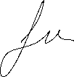













Lecture 8, Activity 2: Breakout rooms, 5 minutes
Notes:
Phi=constant=kx-omeg*t, d/dt Phi=0 → k dx/dt-omeg=0

Slide 8
Lecture 8, Activity 3: (TPS ~ 3 mins)
What are the two possible phase velocities of a free particle in terms of its energy E?
How is this different than the infinite square well and harmonic oscillator examples?
What is another qualitative difference between the previous solutions of the TISE, and this case of the free particle?
Notes:
+/- sqrt(E/2m)
So, different than the infinite square well or HO potentials in that there are degenerate solutions to the TISE (not a one to one correspondence between eigen energies and eigen functions).
The spectrum is continuous, not discrete (value solution for any E>0.

Slide 9
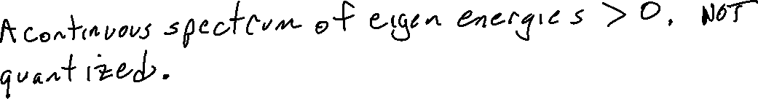
Lecture 8, Activity 3: Breakout rooms ~ 5 mins
What are the two possible phase velocities of a free particle in terms of its energy E?
How is this different than the infinite square well and harmonic oscillator examples?
What is another qualitative difference between the previous solutions of the TISE, and this case of the free particle?
Notes:
+/- sqrt(E/2m)
So, different than the infinite square well or HO potentials in that there are degenerate solutions to the TISE (not a one to one correspondence between eigen energies and eigen functions).
The spectrum is continuous, not discrete (value solution for any E>0.

Slide 10
Lecture 8, Activity 4: Breakout rooms ~ 5 mins
How might you try and find the expected value of the momentum in one of these un-normalizable states? How does your result compare with the phase velocity of the state?
Hint: use the “space not infinite, but rather 2L~ many light years” guess at a “normalizable stationary state”.

Slide 11





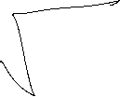












Lecture 8, Activity 4: Breakout rooms ~ 5 mins
Notes:
Seems odd?

Slide 12
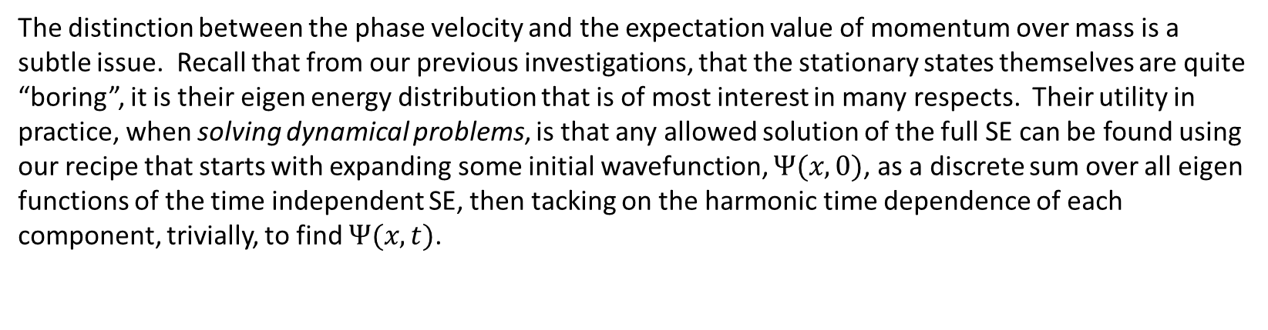
Lecture 8, Activity 5 Wavepackets: (Discussion)
The distinction between the phase velocity and the expectation value of momentum over mass is a subtle issue. Recall that from our previous investigations, that the stationary states themselves are quite “boring”, it is their eigen energy distribution that is of most interest in many respects. Their utility in practice, when solving dynamical problems, is that any allowed solution of the full SE can be found using our recipe that starts with expanding some initial wavefunction, $Ψ(x,0)$, as a discrete sum over all eigen functions of the time independent SE, then tacking on the harmonic time dependence of each component, trivially, to find $Ψ(x,t)$.
It turns out that we can still carry out this same procedure for a particle in free space, even though the eigen functions are technically not normalizable. As we will see, the expansion becomes an integral rather than a discrete sum (which shouldn’t be surprising since the spectrum is now continuous). We won’t go into the mathematical proof, but in essence it is the same as how one can formally go from a Fourier series expansion of a periodic function, to a Fourier transform expansion of a non-period function by carefully taking the limit as the period goes to infinity.
Example: Gaussian wavepacket states: localized, normalizable states made from a continuous superposition of un-normalizable solutions of the TISE in an unbounded potential. They are not technically “stationary”, but if one makes the degree of localization arbitrarily large, they are, effectively.
Notes:
A rigorious way to do the “L on order of lightyears” fudge.
See hand written notes: Gaussian Wavepackt.jnt

Slide 13
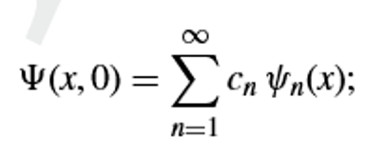
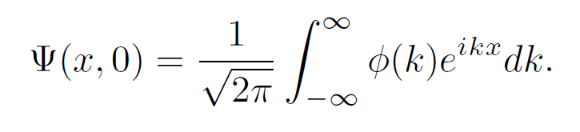
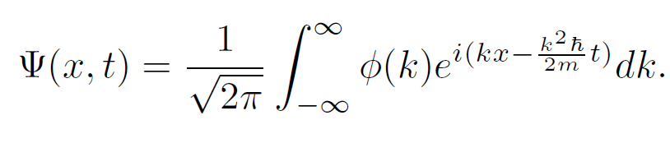
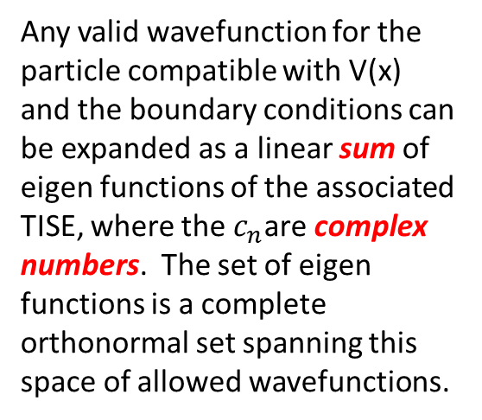

Lecture 8, Activity 5: Wavepackets
Discrete Eigen Spectrum
Continuous Eigen Spectrum for
a Free Particle
The Full Solution to the SE is then:
Any valid wavefunction for the particle compatible with V(x) and the boundary conditions can be expanded as a linear sum of eigen functions of the associated TISE, where the $c_{n}$are complex numbers. The set of eigen functions is a complete orthonormal set spanning this space of allowed wavefunctions.
Any valid wavefunction for the free particle can be expanded as a continuous summation (an integral) over un-normalizable eigen functions with real eigen values k of the associated TISE, where the the expansion coefficients are in the form of a complex function of k, $φ\left(k\right).$

Slide 14
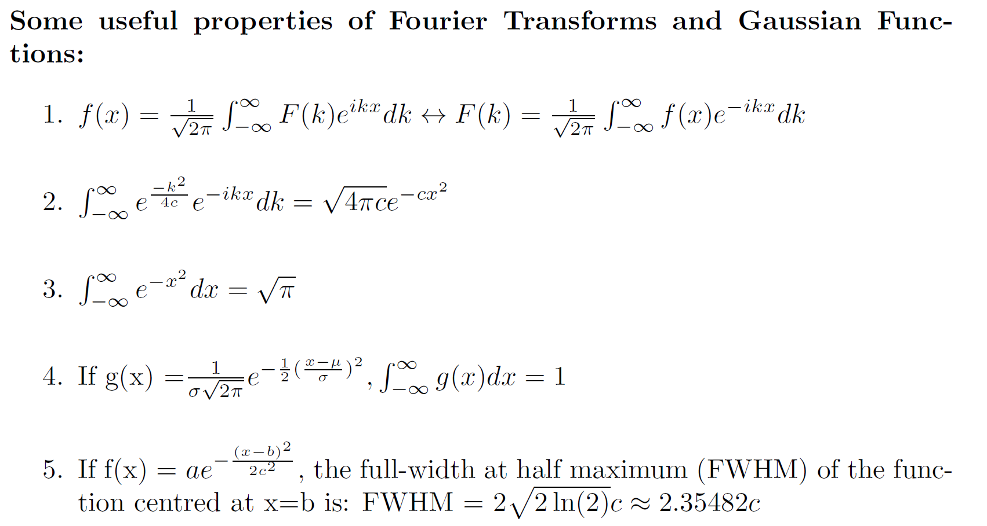
Lecture 8, Activity 5: Wavepackets
Notes:
Get them to see that the only change from general FT math, to the solution of the free particle SE is in recognizing phi(k) is F(k), the fourier transform of the wavefunction.

Slide 15
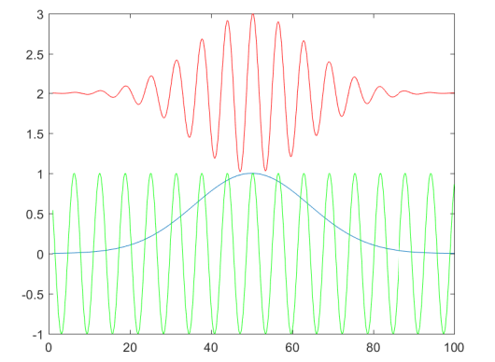




Lecture 8, Activity 5: Wavepackets
Can use the nice analytic properties of Gaussian functions to make the “let L be light years” fudge that we introduced earlier, completely rigorous, as we will see next lecture.
Snapshot of a Wavepacket
$$blue:$$
$$, the "envelope"$$
$${green: Re(e}^{ikx}), the \text{"}\text{carrier}"$$

